Slide 1
FLIGHT GUIDE: SUMMER YOUTH PRACTICUM
PREPARED BY:
ASHLEY CARLISLE, EDUCATION COORDINATOR
TAMRA JONES, 2021 EDUCATION INTERN

Slide 2
WHAT TO EXPECT:
Navigating through the airport can be a scary and stressful process, which is completely okay.
Many people, after traveling for years, still feel stressed and anxious.
A good way to prevent that, is to be prepared & arriving early to the airport! We hope that this Flight Guide can help you to prepare you and minimize any stress, anxiousness and fear.

Slide 3
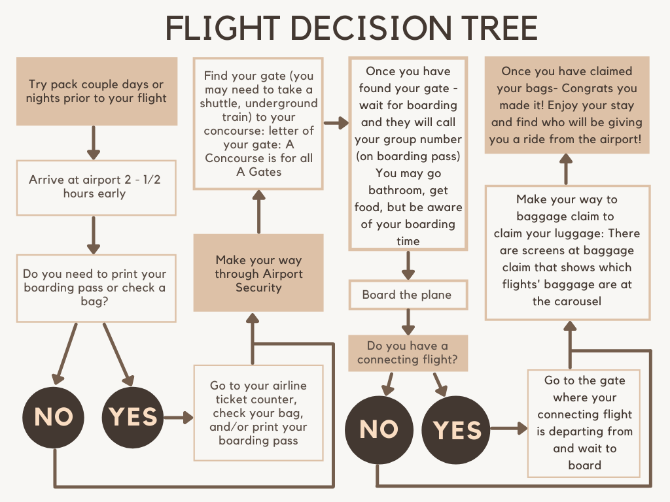
___________________
___________________

Slide 4
BEFORE ARRIVING AT THE AIRPORT
Know your flight number, boarding time and gate:
This information is on your itinerary which was sent by email to your email.
CONFIRM that the information is CORRECT.
Sometimes the gate is not assigned until you get to the airport,
You can look at those big screens to find your flight and gate.
When you find your gate, you can ask the airline employee if you are at the correct gate and can look at the gate screen that displays the flights.

Slide 5
BEFORE ARRIVING AT THE AIRPORT
Obtaining your boarding pass:
Option 1: Print it and bring it to the airport with you.
Option 2: You are allowed to download it on your phone. (Take a screenshot of it just in case!)
Option 3: You can have it printed at the airline ticket counter (area where they print tickets and check your checked baggage).
Option 4: You can print it at the airline kiosks located at the Check-In/Ticketing location for the airline
Option 5: Download the airline app. to access boarding pass, updates of your fight, and in-flight entertainment.

Slide 6
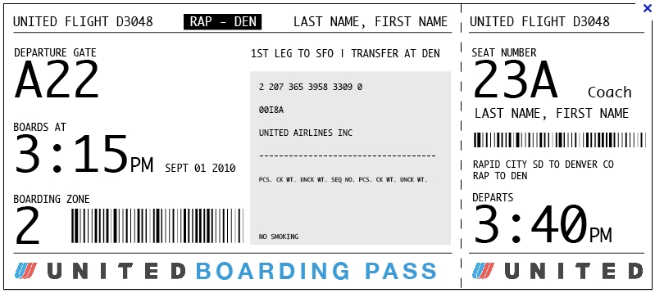
BEFORE ARRIVING AT THE AIRPORT: EXAMPLE BOARDING PASS
This is your flight #. You want to be sure that the gate you are at also matches your flight #.
This is the location in the airport that you will need to be at to board your plane.
Make sure your full name is correct!
This is also called “Boarding Group”, you will board the plane in groups. You will board with your group. Be sure to listen to the flight employee when they call out boarding groups.
This is the time, the airline start boarding your plane. Aim to be at your gate at least 40 minutes before this time. This will allow you to go bathroom, fill your water bottle, get some food/snack and relax.
**YOU WILL NOT BE ALLOWED ON THE PLANE 15 MINUTES BEFORE THE DEPARTURE**

Slide 7
BEFORE ARRIVING AT THE AIRPORT
Know your travel date and time.
Plan to arrive at the airport between 2 – 2 ½ hours BEFORE your flight time.
Be sure you check the baggage policies and fees so you can pack accordingly.
Policies and fees depend on the airline
You can refer to the National SYP Student Packing List to see what you should pack.
See what you can bring through the airport with you, especially through security.
If you plan to bring a personal time and carry-on ONLY, please pay attention to what items you can and cannot bring through security.
P.S. Children under the age of 18 y/o do not need to bring an ID to the airport. We do advise to bring just in case (i.e. school ID, Drivers License or Permit, Tribal ID, State ID).

Slide 8
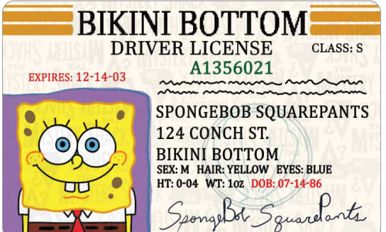
VALID ID?
The best and safest recommendation is you must have an I.D.
Valid ID:
issued by the government, and come with a photo or characteristic, making them unique and fraud proof. It is important to carry at least two forms of identification.
Examples:
U.S. photo driver license or photo ID card
Tribal Photo I.D.
An unexpired U.S. passport
Military Identification

Slide 9
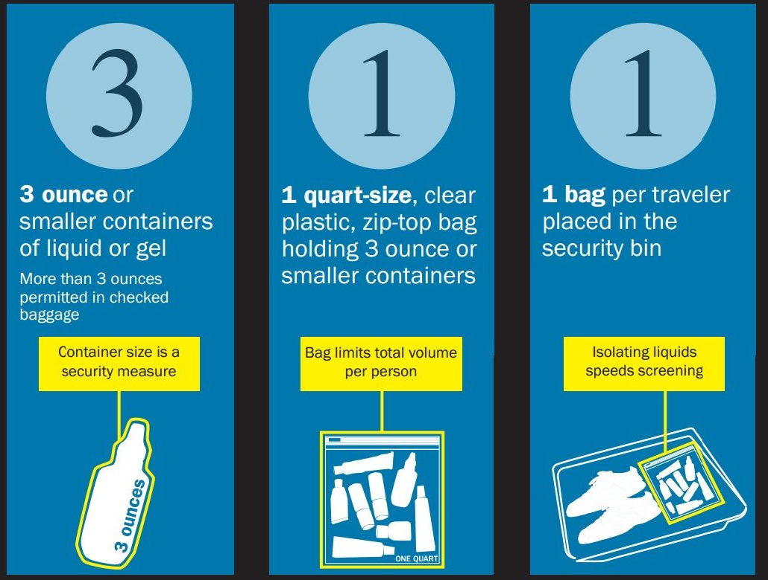
BEFORE ARRIVING AT THE AIRPORT
Be sure you do not have in your personal item, carry-on or in your pockets
Knives, Pocket Knives, Multi-tool, Nail clippers, Weapons
Tip: If you want to bring a water bottle on the plane, be sure to empty the contents completely before going through security. Once you have made it past security, you can refill your water bottle at a water fountain.
For more information about airport security & what you can or cannot bring, go to:
https://www.tsa.gov/travel/security-screening/whatcanibring/all

Slide 10
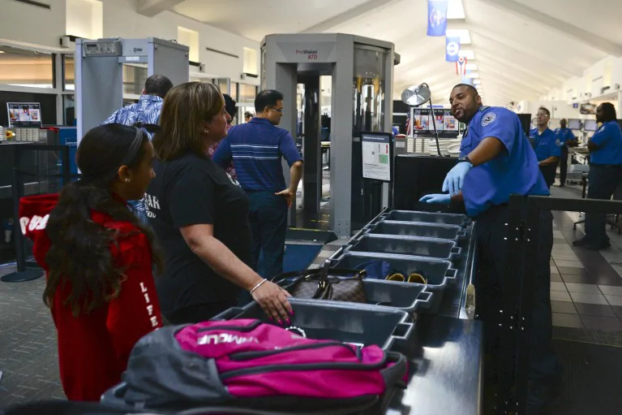
WHAT TO EXPECT AT SECURITY
There will be a long line: so, arrive EARLY!
At the line, you will have to take off your shoes, jacket, belt, watch, jewelry and COMPLETELY empty out your pockets – you will place all these items into a plastic bin
If you have any electronics in your bag: you will have to place them into their own separate plastic bin (laptops, phones, iPad)
Backpacks, purses, and small suitcases will be put on the line then pushed down the line to be scanned
Stay by your bin until it gets pushed into the tunnel where it is then scanned, then you will be guided into the security clearance area
Once you have been cleared, you can collect all your items! Be sure to grab everything from the plastic bins.

Slide 11
BAGGAGE
A PERSONAL ITEM: purse, handbag, backpack, laptop bag, suitcase
Able to fit underneath the airplane seats
Carry through the airport, security, and take it on the plane with you
A CARRY ON: small suitcase, duffel bag
It needs to be able to fit in the overhead bin of airplane (storage above the airplane seats)
Carry through the airport, security, and take it on the plane with you
A CHECKED BAGGAGE: large suite case (does not exceed 50 pounds) that you check at the airline ticket counter, may be associated with fees
Airline workers will place a tag on the suitcase and place it behind them to be put under the plane storage
Do not carry to security or take on the plane with you – since you checked the baggage the airline will take it
P.S. It is good to attach a ribbon or name tag onto your carry on and luggage, so you can easily identify the checked baggage in baggage claim

Slide 12
CHECKED BAGGAGE
You will give your checked baggage to the airline people BEFORE going through airport security, you will have to wait in line, go to the counter, provide your ID, then they will charge you for checked baggage put a tag on it then take it. Here you can also have them print your boarding pass (YOU WILL NEED THIS TO GET THRU SECURITY AND BOARD ON THE PLANE)
Depending on your airline & ticket: you may have to pay for a checked bag, costs vary so be sure you keep that in mind as you pack and go to the airport
Checked bags can’t exceed 50 lbs., if it does you have to pay extra (extra can range from $30-75)
In your checked baggage:
You are allowed to bring big liquids & gels (bottles of shampoo, conditioner, body soap, hairspray, perfume, cologne, etc.)
Helpful Tip: Due to the air pressure changes that occur while flying, bottled items expand and can leak their contents all over your bag. It is frustrating when this happens so to help with this, it may be a good idea to put lotions, body wash, shampoo and conditioner etc. into a Ziploc bag to avoid it getting all over everything just in case this does occur.

Slide 13
CARRY ON ITEMS
Some things to bring that will help make your flight more enjoyable!
Comfy clothes
Comfy mask
Headphones
Travel pillow
Travel blanket
Reading Material
Crosswords
Sunglasses
Chapstick
Chewing Gum and other snacks
Earbuds
Tylenol
Hand sanitizer
Water Bottle

Slide 14
BAGGAGE
Links to all the airline baggage policy/fees pages:
Frontier
Frontier: Baggage Fees and Policy – SeatGuru
Delta
Baggage Policy and Fees | Delta Air Lines
United
United Airlines Baggage Fees, Policy & Allowance [2021] (upgradedpoints.com)
Southwest
Baggage Policies (southwest.com)
American Airlines
https://www.aa.com/i18n/travel-info/baggage/baggage.jsp?anchorEvent=false&from=Nav
Spirit
Spirit Airlines Baggage Fees & Policy [2021 Update] (upgradedpoints.com)

Slide 15
NAVIGATING TO YOUR GATE
Woohoo! You made it through security- I know that can be the most nerve-racking part of travelling. The good news is, you won't have to go through that again until you are on your way back home!
Now that you are through security, find what gate your flight will be leaving from and go to that area. Sign postings are your best friend in airports, they are very thorough, so just follow the signs!
Your gate number should be on your boarding pass, if not, go to the big electric monitors and find your flight number/airline/destination and the gate should be displayed

Slide 16
AT THE GATE
Congrats! You made it through the hard part!
Once you are at your gate, double check that you are at the correct gate, the screens will usually display your destination, flight number, flight time, and boarding time.
Be sure, that you are at your gate by Boarding Time.
The airline will board before the flight and will close the doors about 15-20 minutes before your flight time. IMPORTANT!
In Example: If your flight is at 8:30 am, Your Boarding Time may be 8:00am, and they will close airplane door at 8:15am. If you are at your gate at 8:17am, you cannot board your plane and will miss your flight.
When it is time, they will call your row/seat number. Be sure to have your boarding pass ready to scan, take your seat, and enjoy your flight!

Slide 17
LOST BAGGAGE
If you decide that you are going to check a bag, there is potential that the airline might misplace your luggage. If you are standing at baggage claim waiting for your luggage to come onto the designated carousel and it never does. This usually means that the airline has misplaced your luggage. If this happens, these are the steps you want to follow.
Step 1: Just to be sure, double check that you are at the correct baggage claim
Step 2: Locate the baggage desk for the airline that operated your final flight
Step 3: Inform the agent about your missing bag
Step 4: File a missing baggage report
While you’re filing a report, be sure to ask what the airline is willing to provide for compensation as well as to what extent it will reimburse you.
Hopefully, the airline will be able to locate your bag and return it as soon as possible. In the meantime, you may need to purchase essential items while you wait for your items to be returned back to you. (Keep the original receipts and the airline should reimburse you)
Helpful Tip: Bring a carry on and always keep all essential/valuable items with you!

